Slide 1

TRANSFORM YOUR FITNESS JOURNEY
INTO AN EPIC RPG ADVENTURE
BROUGHT TO YOU BY RORY | ANNABEL | NENE | DYLAN
Notes:
INTRO - NENE

Slide 2
“Our app is a gamified gym app that aims to make working out more enjoyable and motivates people to get into fitness in a fun way. Where exercise focuses on delayed gratification, Dumbbells & Dragons brings instant gratification to the user. “
THE
MISSION
Notes:
PROBLEM DOMAIN - RORY

Slide 3
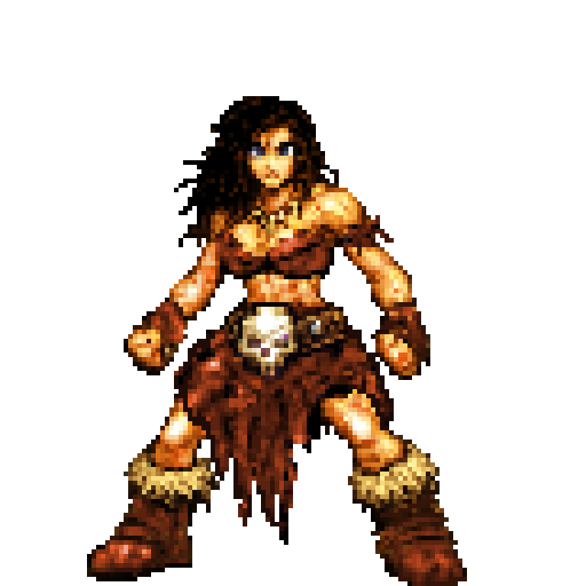
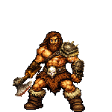
CHARACTER CLASSES
PERSONAL PROFILE
ACCOUNT CREATION
EARN XP
PROGRAMS
WORKOUT LOG
THE
SOLUTION
NOTIFICATIONS
LEVEL UP
SOUNDS & ANIMATION
CHANGE CHARACTER
‘THE TAVERN’
Notes:
USER STORIES - CORE (TOP) & STRETCH (BOTTOM) - DYLAN

Slide 4
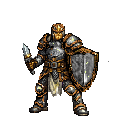
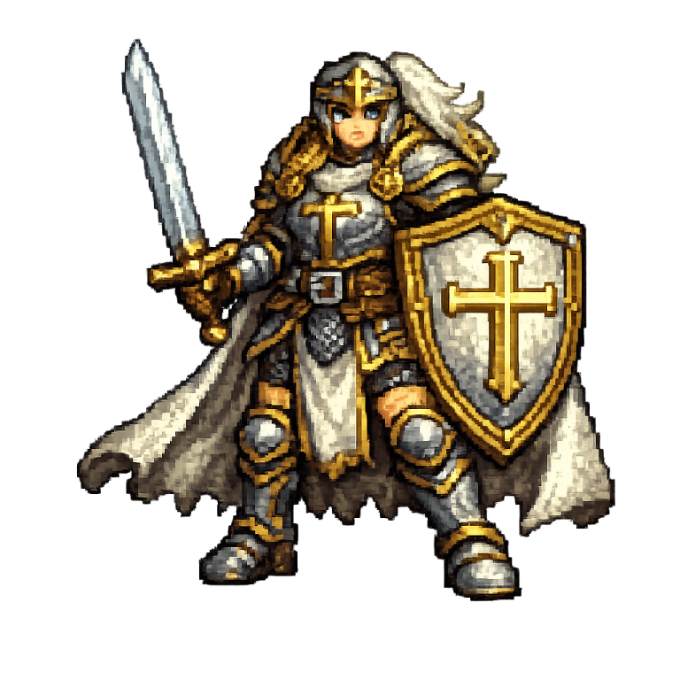
THE NEXT CHAPTERS
Chapter 1 2026
Chapter 2 2026
Chapter 3 2026/2027
Chapter 4 2027
Character creation with 3 classes
8-week structured programs
workout logging with real-time XP tracking
Character leveling system
User authentication with clerk
Responsive design
Program overview page
The Tavern (Complete with Leaderboards & Social features)
Dynamic character avatars based on level/class
Workout history page (with progress graphs)
Achievement system with badges
Quest system (weekly challenges)
Guild/Party features
Custom program builder/editor
Exercise video library
More Social features (following, workout sharing)
Progressive web app (PWA) for offline logging
Wearable device integration
Nutrition tracking
Stand alone game (2d dungeon crawler/rpg/loot)
Better character customisation
Notes:
ROADMAP - RORY

Slide 5
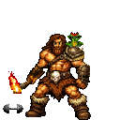
FIGMA WIREFRAMES
High fidelity wireframes for each page
Allows for easier translation when coding started
USER FLOW MAPPING
Detailed user flow created early on
required pages and redirects became much clearer
DATABASE DESIGN
The most complex part of our app as foundational
Collaboratively design the database schema
Majority of planning days spent on this
THE
PLANNING
Notes:
PLANNING - NENE

Slide 6
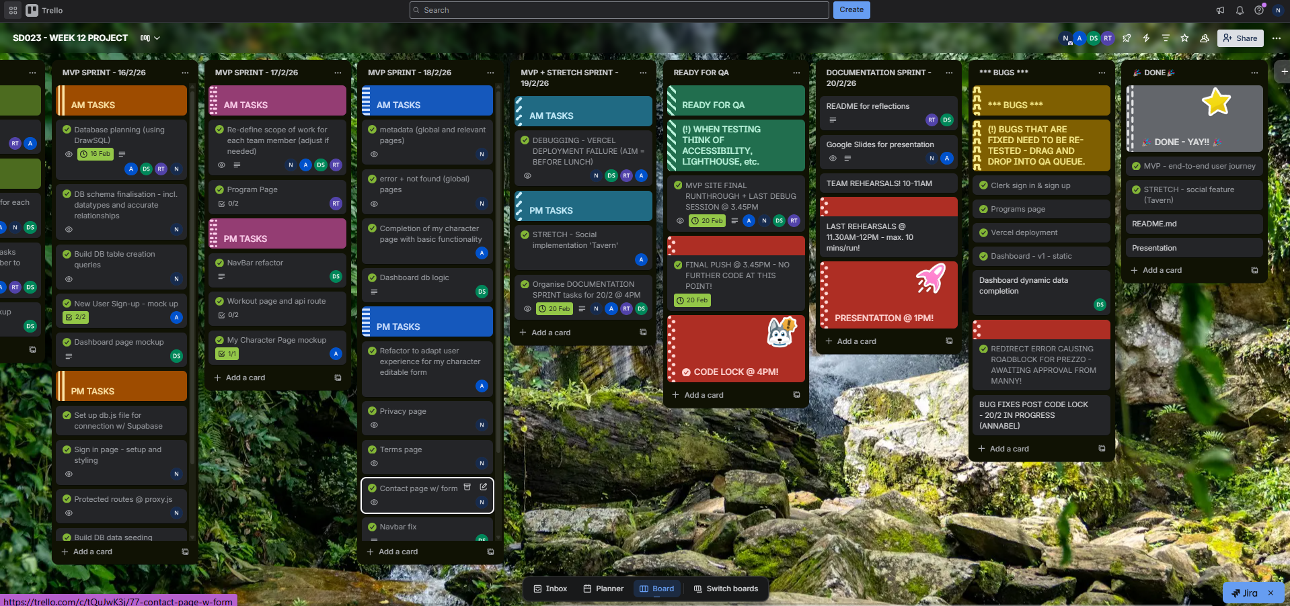
TRELLO
OUR PROJECT MANAGEMENT HUB
Notes:
NENE

Slide 7
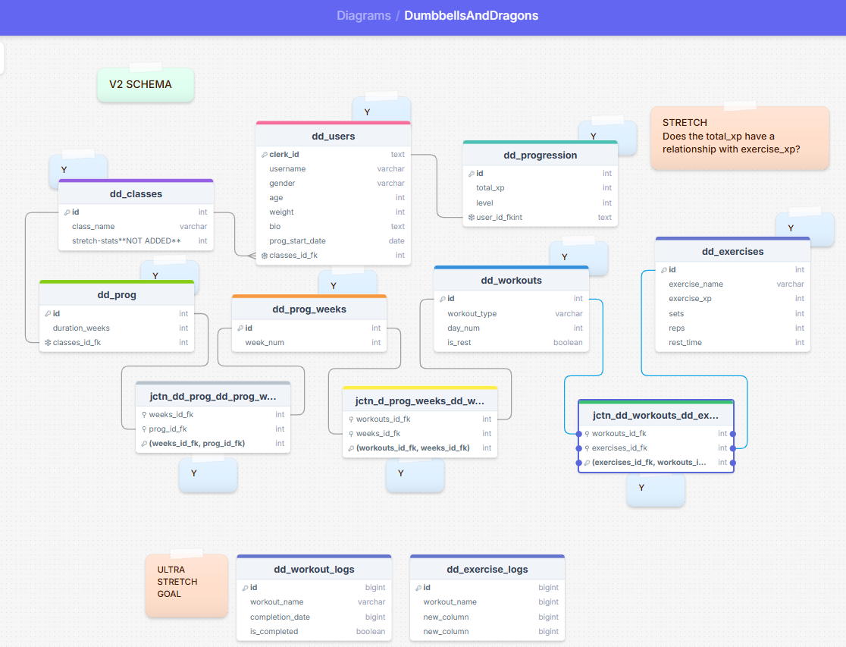
DRAWSQL
OUR DATABASE SCHEMA - v1
Notes:
NENE

Slide 8
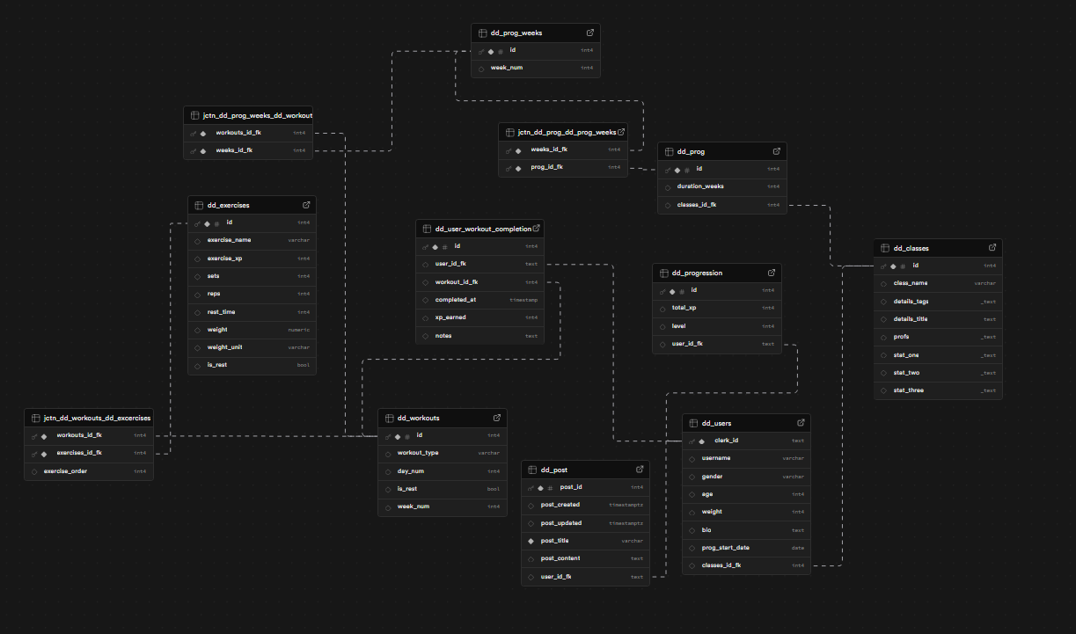
SUPABASE
OUR DATABASE SCHEMA - v2
Notes:
NENE

Slide 9
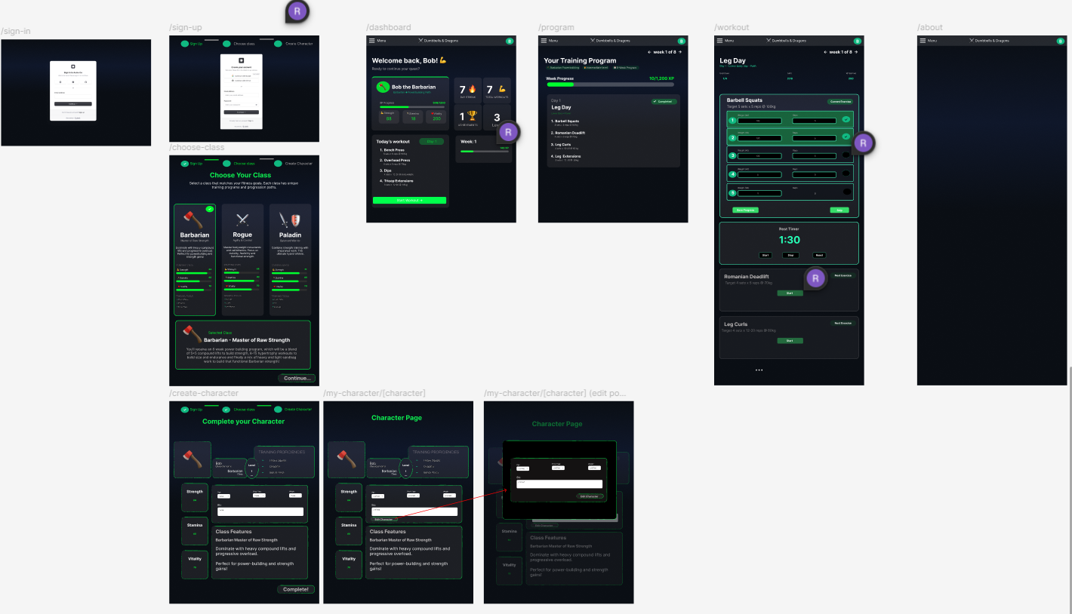
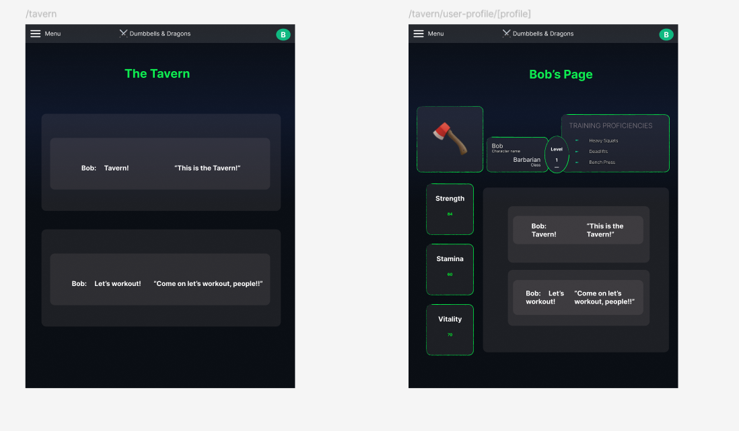
FIGMA
LO-FI AND HI-FI WIREFRAMES
Notes:
ANNABEL

Slide 10
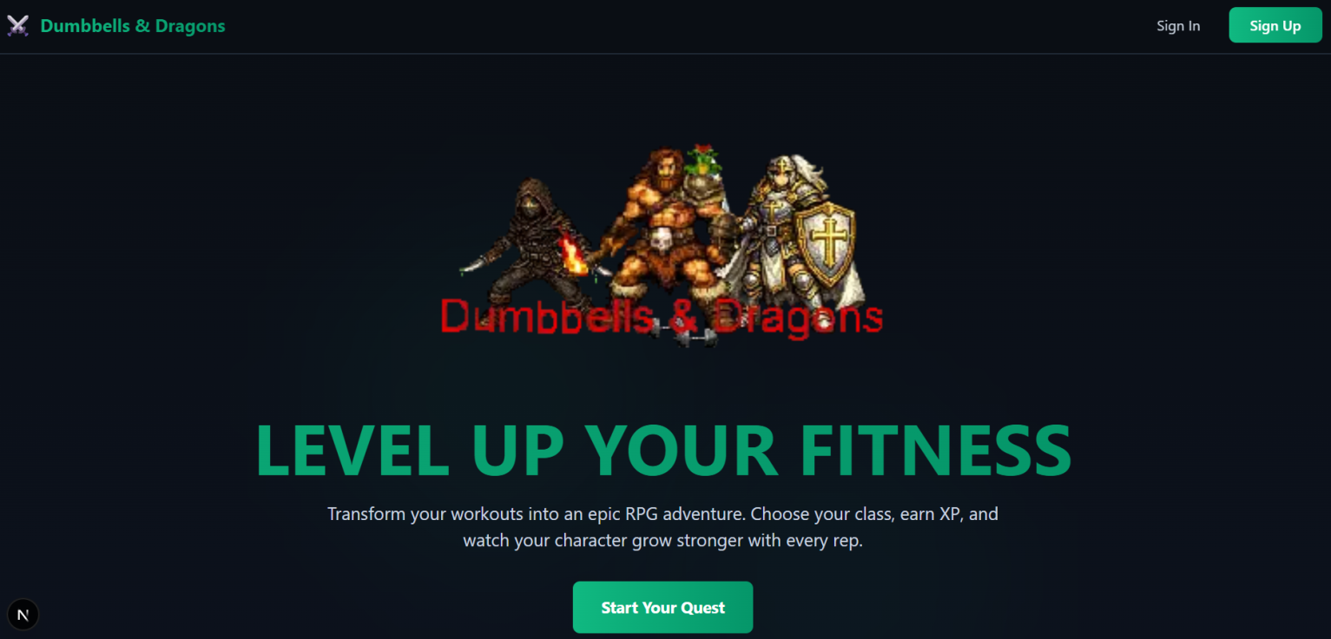
THE PRODUCT
Notes:
DEMO SLIDE **HYPERLINK ON WEBSITE TAKES YOU TO LIVE VERCEL DEPLOYMENT** - ANNABEL

Slide 11
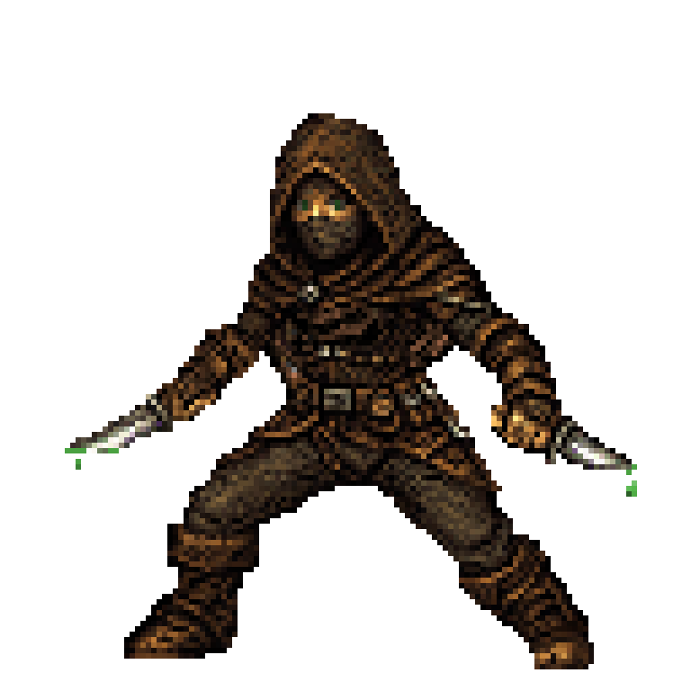
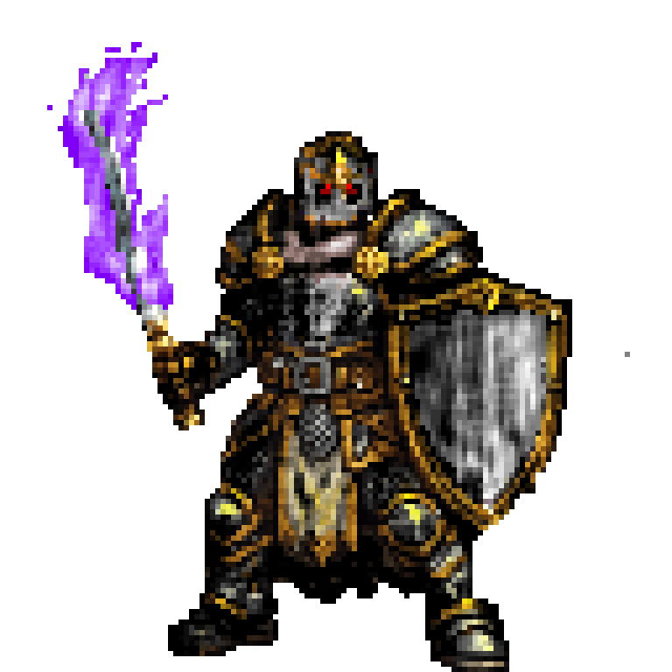
COLLABORATION
STANDUP MEETINGS
9.30AM standup
1PM standup
post-lunch
4PM GIT meeting
Regular check-ins
COMMUNICATION PLAN
Group Discord server
with topic-specific channels
Multiple voice channels for pair programming
No guaranteed responses after 5:00pm
Trello as central hub
CONFLICT MANAGEMENT
1 on 1 discussion on issues
Group discussion if unresolved
Bring in Manny or Bertie ASAP if needed
All else fails, fist fight!
HOUSEKEEPING IS KEY!
Notes:
DYLAN

Slide 12
REFLECTIONS
“This has been something i've wanted to build since working as a personal trainer 2 years ago, so i'm super excited to see it being brought to life by an excellent team”
- Rory -
“A maddening, but exciting journey with a most satisfying crescendo. What a ride!”
- Nene -
“Handling SQL queries for this project, as well as utilising components to make pages dynamic was a feat that definitely felt as if it aged me…”
Annabel -
“By far the most complex database I’ve ever worked with, but the project itself being so interesting made the struggle worth it.”
- Dylan -
Notes:
REFLECTIONS ALL - ANNABEL, DYLAN, MYSELF, RORY

Slide 13
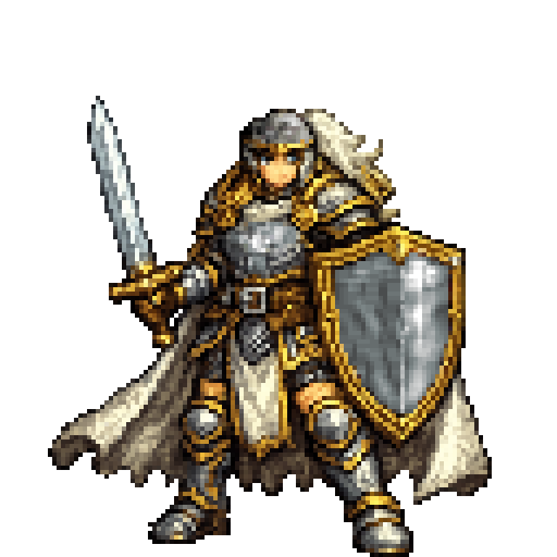
THANK YOU!

